Slide 1




Business Insights 360
Presented by: Ankit Tripathi
by ANKIT TRIPATHI
Content
Atliq Hardware: Business Model
Company Challenges
Company Expectations
Data Model and Data Description
Key Business Insights
Strategic Recommendations

Slide 2

Atliq Hardware: Business Model
Manufacturer
B2B & B2C
PC peripherals like mice, printers, and accessories.
Sells to businesses and directly to consumers.
Global Supply Chain
Operates across multiple regions with optimized logistics.

Slide 3
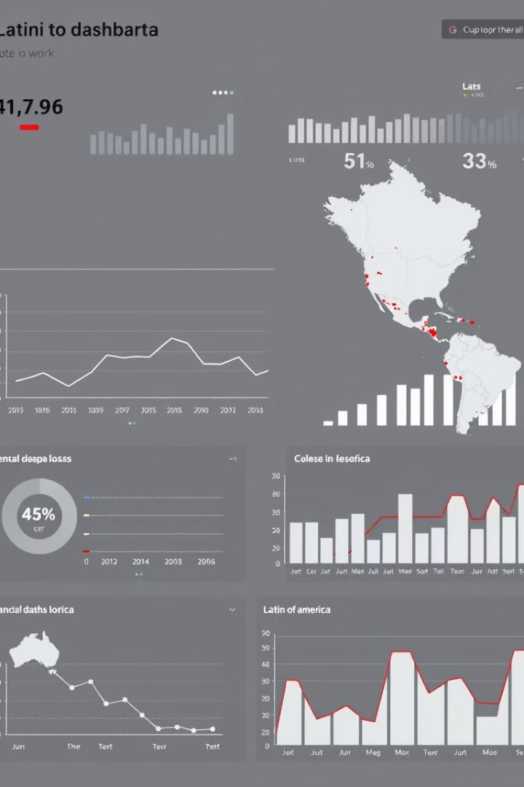
Company Challenges
1
Latin America Losses
2
Excel Limitations
Excel-based analysis is no longer scalable.
Expansion based on surveys led to strategic failures.
3
Competitive Pressure
Dell leverages data analytics for insights.

Slide 4




Company Expectations
Data Storytelling
Efficient Communication
Time-Saving Dashboards
Transform raw data into meaningful insights.
Provide key insights at a glance.
Deliver structured, clear, and concise insights.

Slide 5
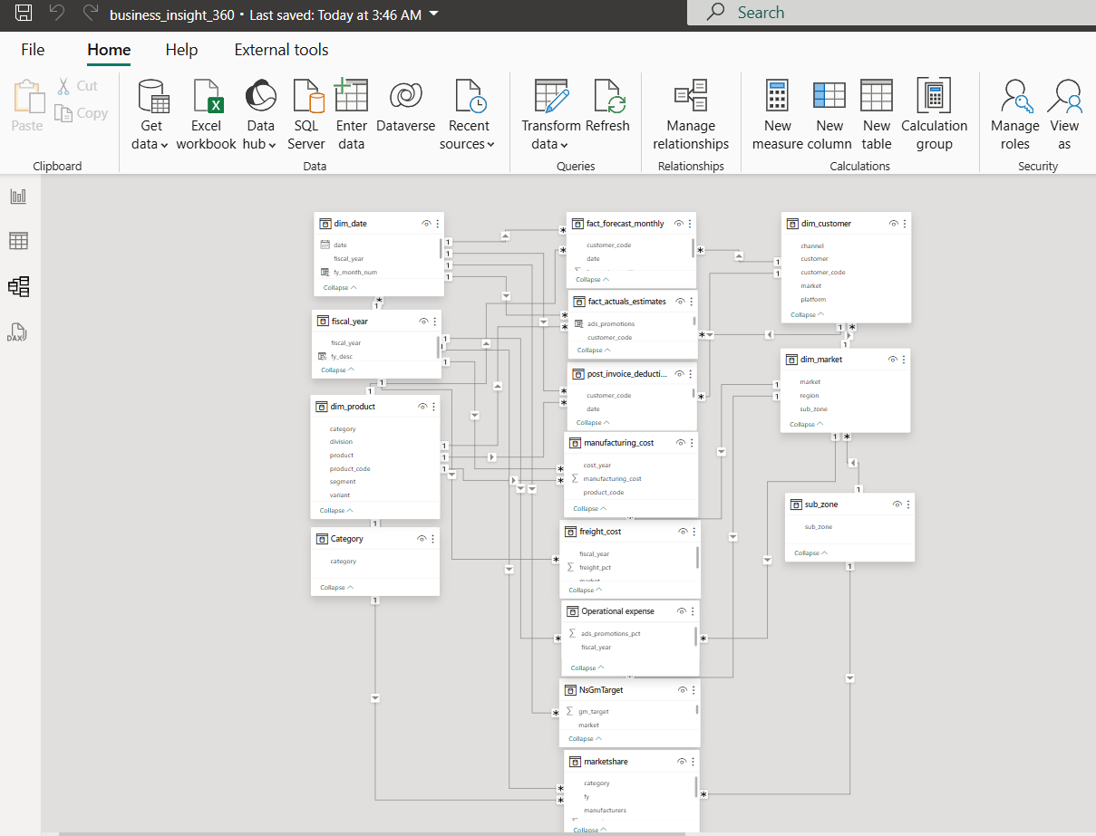
Data Model and Data Description
🌨️ Snowflake Data Model
The Snowflake schema breaks down dimension tables into smaller, related sub-tables, forming a structured, efficient, and storage-optimized model. This reduces redundancy and enhances query performance, making data retrieval seamless.
📊 Data Description
Our data is sourced from SQL Databases and Excel Files, each serving a unique purpose:
🔹 SQL Databases:
GDB041 – Customer, Product, Market, Sales & Forecast data
GDB056 – Manufacturing Costs, Invoice Deductions, Freight & Pricing
🔹 Excel Files:
Market Share – Competitive landscape & Atliq’s position
Operational Expenses – Advertising & promotions spending
Target 2020 – Sales goals provided by product owners

Slide 6
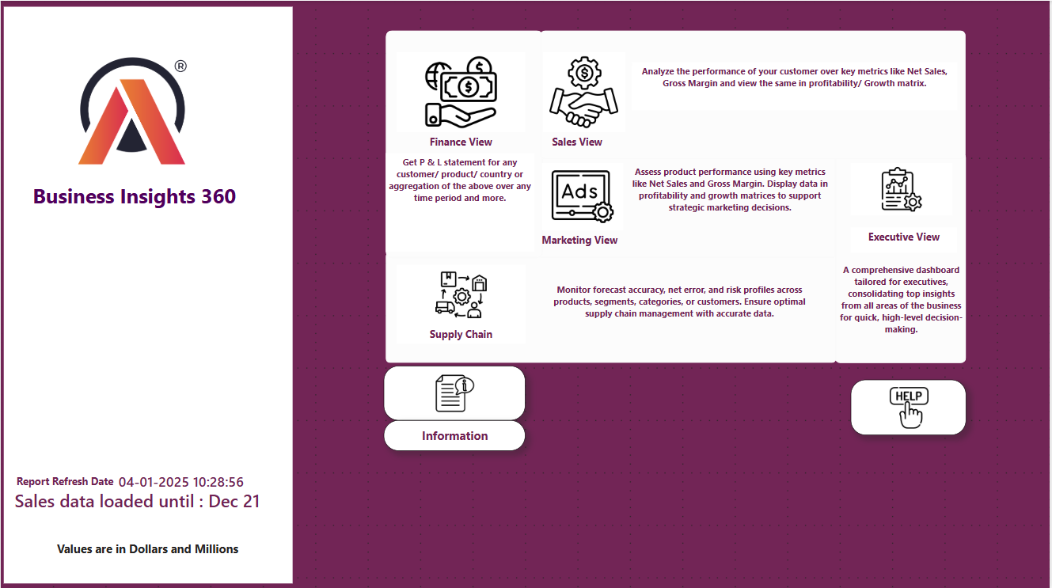

Slide 7
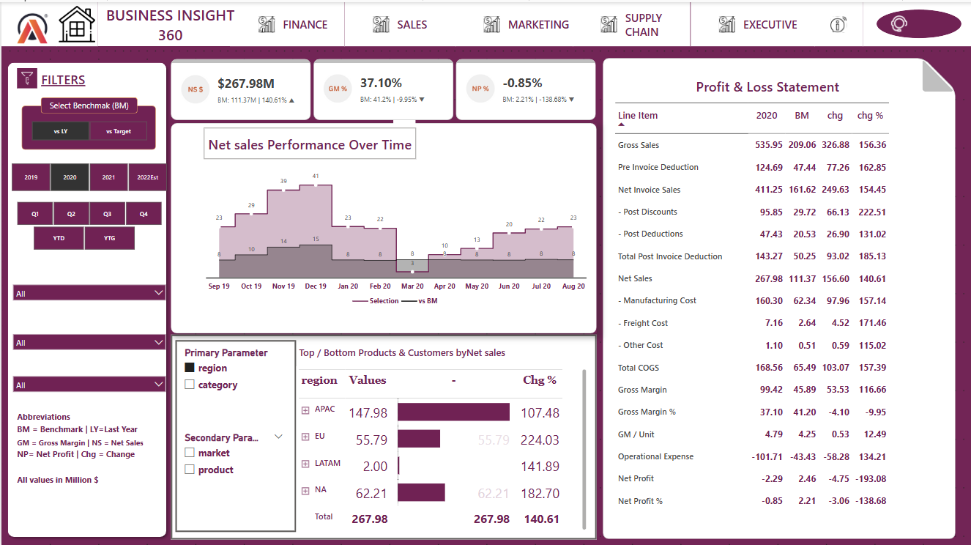

Slide 8
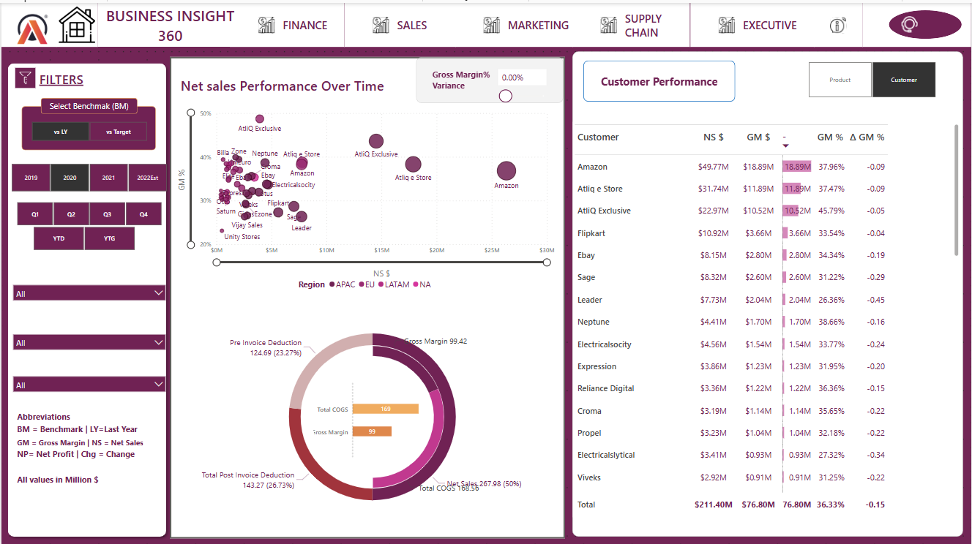

Slide 9
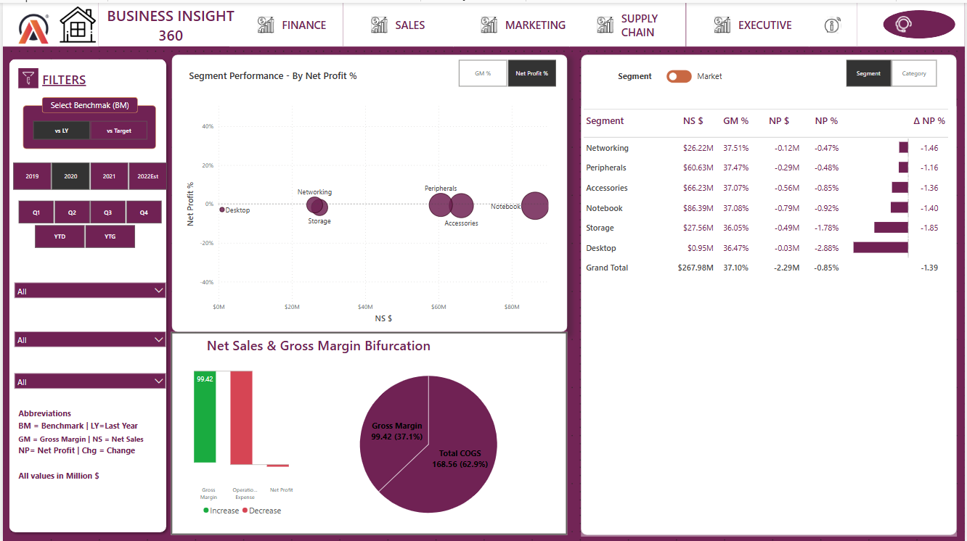

Slide 10
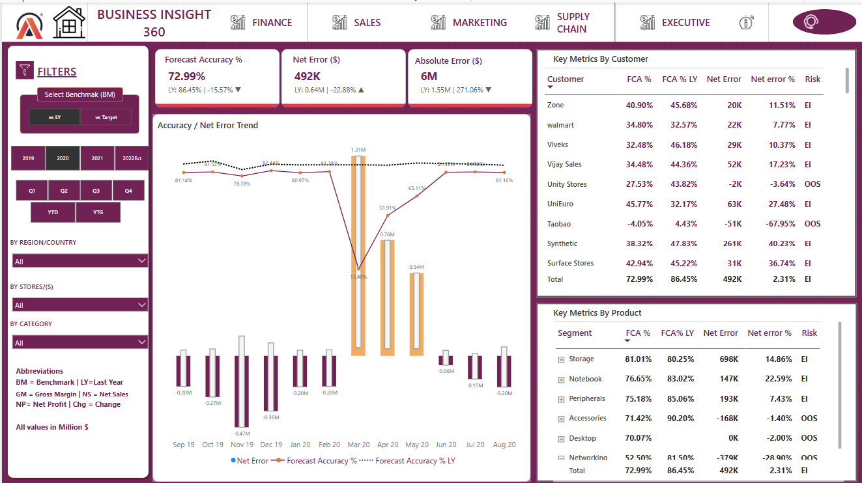

Slide 11
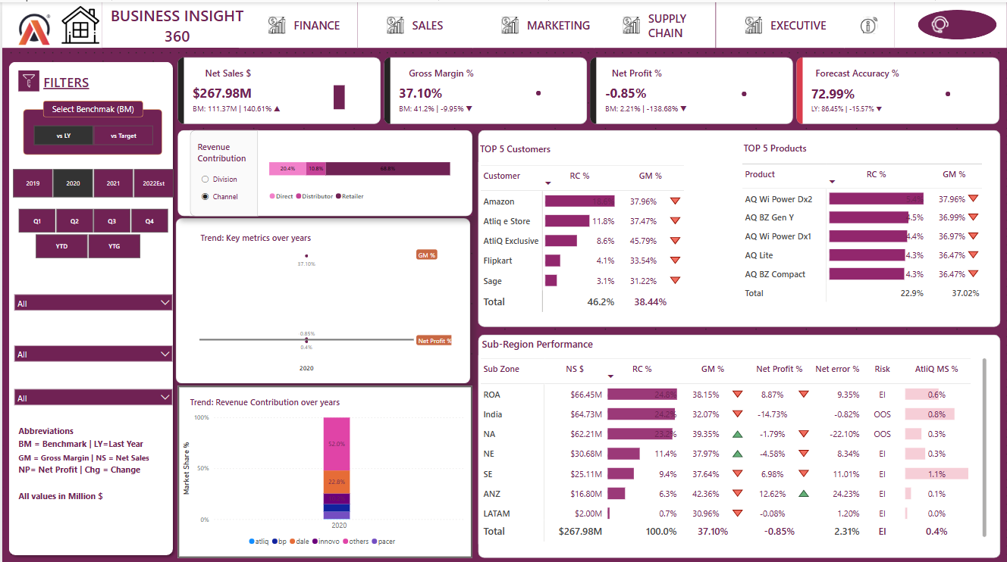

Slide 12
Key Business Insights
Finance
Sales
Marketing
353.5% growth in Net Sales (FY 2022).
Amazon & AtliQ Exclusive: $496.9M & $361.1M.
APAC: Highest sales volume contributor.
14% Loss due to rapid expansion since 2021.
Best-selling product: AQ HOME All-in-1 Gen 2.
Spain: Most profitable market (7.7% Net Profit).

Slide 13





Strategic Recommendations
Financial Optimization
Reduce operational expenses during expansion.
Marketing & Sales Growth
Boost engagement during peak seasons.
Inventory & Supply Chain
Optimize inventory levels to avoid stockouts.
Market Penetration
Analyze consumer behavior in LATAM.

